Slide 1
Data Stream Mining Introduction, Concepts and Issues -

Slide 2
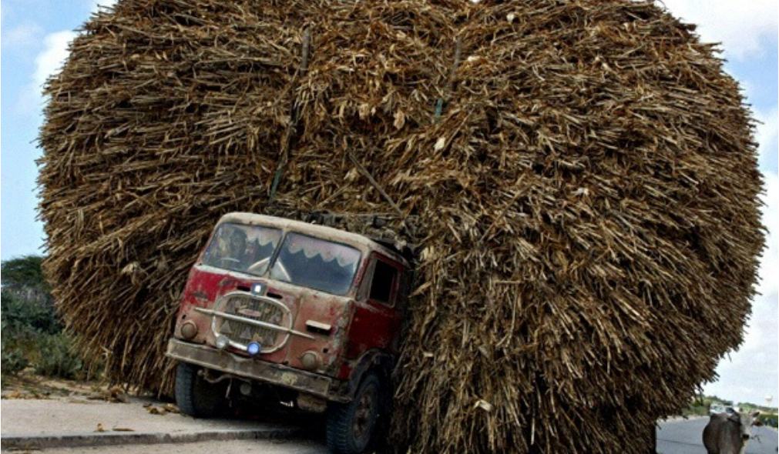
Present of Big data- Too Big to Handle…
Big Data is data whose characteristics force us to look beyond the tried-and-true methods that are prevalent at that time

Slide 3

Future of Big data- Drinking From a Firehouse

Slide 4
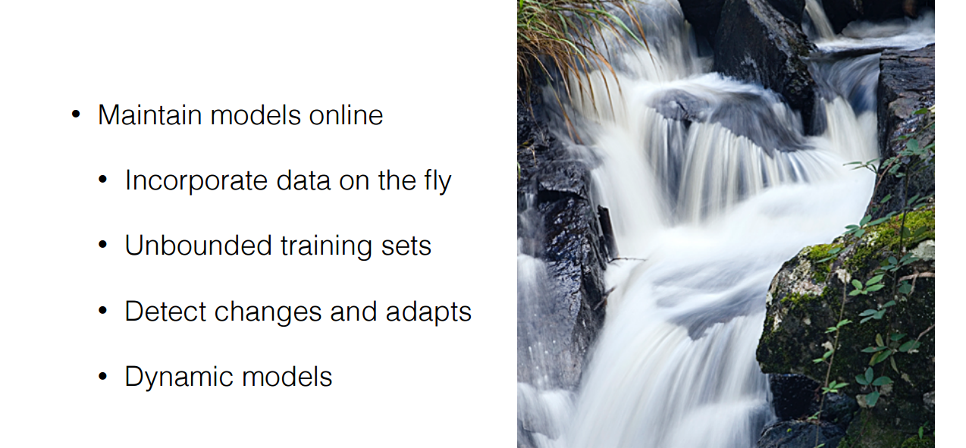

Slide 5

Data Streams
  Data streams—continuous, ordered, changing, fast, huge amount
  Traditional DBMS—data stored in finite, persistent data sets
Characteristics
  Huge volumes of continuous data, possibly infinite
  Fast changing and requires fast, real-time response
  Data stream captures nicely our data processing needs of today
  Random access is expensive—single scan algorithm (can only have one look)
  Store only the summary of the data seen thus far
  Most stream data are at pretty low-level or multi-dimensional in nature, needs multi-level and multi-dimensional processing
J. Leskovec, A. Rajaraman, J. Ullman: Mining of Massive Datasets, http://www.mmds.org

Slide 6
DBMS vs. DSMS #1
SQL Query
Result
Continuous Query (CQ)
Result
Query Processing
Query Processing
Main Memory
Main Memory
Data Stream(s)
Data Stream(s)
Disk

Slide 7
DBMS vs. DSMS #2
Traditional DBMS:
  stored sets of relatively static records with no pre-defined notion of time
  good for applications that require persistent data storage and complex querying
DSMS:
  support on-line analysis of rapidly changing data streams
  data stream: real-time, continuous, ordered (implicitly by arrival time or explicitly by timestamp) sequence of items, too large to store entirely, not ending
  continuous queries

Slide 8
DSMS Applications
Pull-based
Sensor Networks
  E.g. TinyDB. See earlier lecture by Jarle Søberg
Network Traffic Analysis
  Real time analysis of Internet traffic. E.g., Traffic statistics and critical condition detection.
Financial Tickers
  On-line analysis of stock prices, discover correlations, identify trends.
Transaction Log Analysis
  E.g. Web click streams and telephone calls
Push-based

Slide 9
Data Streams - Terms
A data stream is a (potentially unbounded) sequence of tuples
Each tuple consist of a set of attributes, similar to a row in database table
Transactional data streams: log interactions between entities
  Credit card: purchases by consumers from merchants
  Telecommunications: phone calls by callers to dialed parties
  Web: accesses by clients of resources at servers
Measurement data streams: monitor evolution of entity states
  Sensor networks: physical phenomena, road traffic
  IP network: traffic at router interfaces
  Earth climate: temperature, moisture at weather stations

Slide 10
General Stream Processing Model
Ad-Hoc
Queries
Processor
. . . 1, 5, 2, 7, 0, 9, 3
. . . a, r, v, t, y, h, b
. . . 0, 0, 1, 0, 1, 1, 0
time
Streams Entering.
composed of
elements/tuples
Standing
Queries
Output
Limited
Working
Storage
Archival
Storage
J. Leskovec, A. Rajaraman, J. Ullman: Mining of Massive Datasets, http://www.mmds.org

Slide 11
Generic DSMS Architecture
Input
Monitor
Working
Storage
Summary
Storage
Static
Storage
Output
Buffer
Query Processor
Query
Reposi-
tory
Streaming
Inputs
Streaming
Outputs
Updates to
Static Data
User
Queries
[Golab & Özsu 2003]

Slide 12
Problems on Data Streams
Types of queries one wants on answer on
a data stream: (we’ll do these today)
  Sampling data from a stream
    Construct a random sample
  Queries over sliding windows
    Number of items of type x in the last k elements
    of the stream

Slide 13
Problems on Data Streams
Types of queries one wants on answer on
a data stream: (we’ll do these next time)
  Filtering a data stream
    Select elements with property x from the stream
  Counting distinct elements
    Number of distinct elements in the last k elements
    of the stream
  Estimating moments
    Estimate avg./std. dev. of last k elements
  Finding frequent elements

Slide 14
Stream Mining Algorithms
More algorithms for streams:
  (1) Filtering a data stream: Bloom filters
    Select elements with property x from stream
  (2) Counting distinct elements: Flajolet-Martin
    Number of distinct elements in the last k elements
    of the stream
  (3) Estimating moments: AMS method
    Estimate std. dev. of last k elements
  (4) Counting frequent items

Slide 15
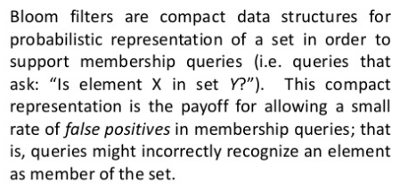
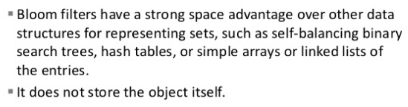
Bloom Filter – Filtering a Data Stream

Slide 16


Bloom Filter – Filtering a Data Stream

Slide 17
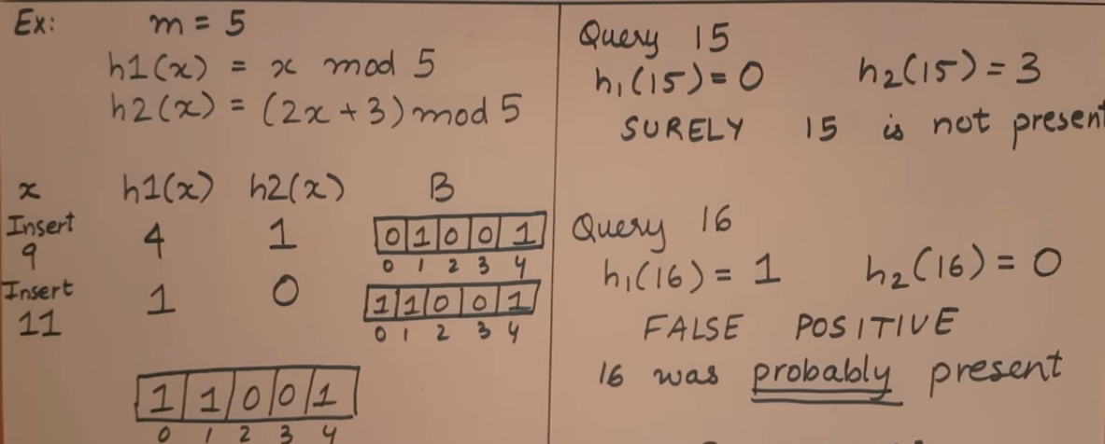
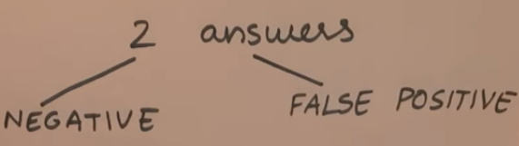

Slide 18
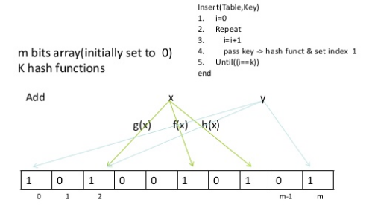
Bloom Filter – Algorithm (Add Query)

Slide 19
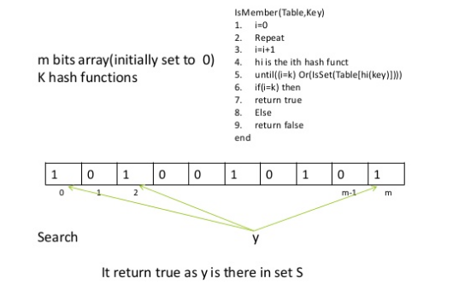
Bloom Filter – Algorithm (Search Query)

Slide 20
Bloom Filter - Example
Use N = 11 bits for our filter.
Stream elements = integers.
Use two hash functions:
  h₁(x) =
    Take odd-numbered bits from the right in the binary representation of x.
    Treat it as an integer i.
    Result is i modulo 11.
  h₂(x) = same, but take even-numbered bits.

Slide 21
Bloom Filter - Example
Stream
element
h₁
h₂
Filter contents
00000000000
25 = 11001 5 2 00100100000
159 = 10011111 7 0 10100101000
585 = 1001001001 9 7 10100101010
Note: bit 7 was already 1.

Slide 22
Bloom Filter - Lookup
Suppose we have the same Bloom filter as before, and we have set the filter to 10100101010.
Lookup element y = 118 = 1110110 (binary).
h₁(y) = 14 modulo 11 = 3.
h₂(y) = 5 modulo 11 = 5.
Bit 5 is 1,
But bit 3 is 0, so we are sure y is not in the set.

Slide 23
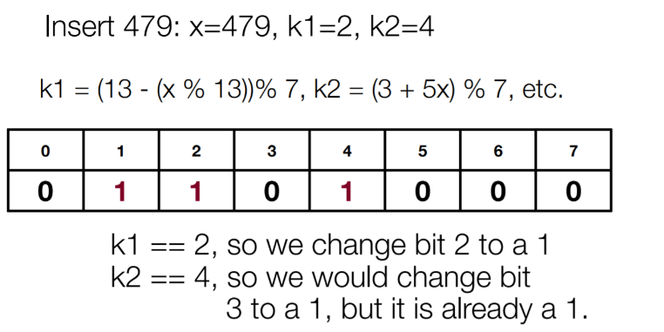

Slide 24
